Slide 1



JUICE- Join Us In Creating Energy
Creating an environment of working cohesively and being able to build productive working relationships
Proposal version 1.0/ 6th September 2017

Slide 2

INDEX
Why Maynardleigh . . . . . . . . . . . . . . . . . . . . . . . . . . . . . . .3
Your Need As we Understand. . . . . . . . . . . . . . . . . . . . . . 4
Our Approach . . . . . . . . . . . . . . . . . . . . . . . . . . . . . . . . . . .5
Diagnosis. . . . . . . . . . . . . . . . . . . . . . . . . . . . . . . . . . . . . . . 6
Design . . . . . . . . . . . . . . . . . . . . . . . . . . . . . . . . . . . . . . . . .7
Sample workshop objectives . . . . . . . . . . . . . . . . . . . . . . 8
Workshop Design. . . . . . . . . . . . . . . . . . . . . . . . . . . . .9-10
Discovery . . . . . . . . . . . . . . . . . . . . . . . . . . . . . . . . . . . . . 11
Room Layout . . . . . . . . . . . . . . . . . . . . . . . . . . . . . . . . . . .12
Things required . . . . . . . . . . . . . . . . . . . . . . . . . . . . . . . . .13
Your Investment. . . . . . . . . . . . . . . . . . . . . . . . . . . . .14,15
Next Steps . . . . . . . . . . . . . . . . . . . . . . . . . . . . . . . . . . . . .16

Slide 3





Why Maynard Leigh?
We understand that each team, company, industry has it’s unique needs. We follow an exhaustive 4-D process to customize interventions.
Over 29 years of experience of delivering work across the globe out of our offices in UK, India and US.
Methodology uses Theatre, Psychology & L & D tools to create experiential learning
With years of research, have their own philosophies published with leading publishing houses like Financial times, Pearson, DK etc
Have worked with leaders at GSK, Fortishealthcare, Maxhealthcare, Coca Cola, American Express, RBS, HSBC etc.

Slide 4
Your need as we understand
There are about 10 young recruits who have recently been hired by SRF in the CTG wing. They are between the age group of 22-23 years. This is their first job and most of them are graduates with a B.Tech degree while two of them have an M.Tech degree. They are all individual performers. This group recently went through a Campus to SRF workshop which was conducted by Maynard Leigh when they were first inducted into the organization.
Situation
There is an opportunity to develop these individuals and align them to the competencies of SRF as on organization. The stakeholders want them to be developed on the following competencies :-
Team working and Collaboration
Ownership
Learnability/Learning Attitude
Creativity and Innovation
Opportunity
Need
SRF would like Maynard Leigh to conduct a 1 day workshop to induct these participants on the mentioned competencies and business’s key expectations from them.

Slide 5
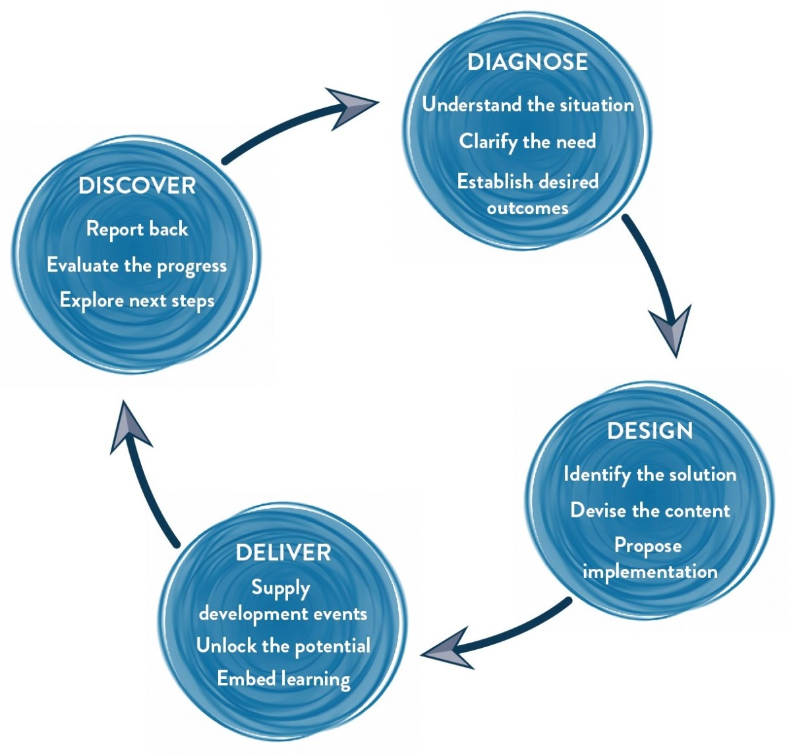
Our Approach
Methodology
We use Interactive theatrical exercises along with Psychological and L & D tools

Slide 6
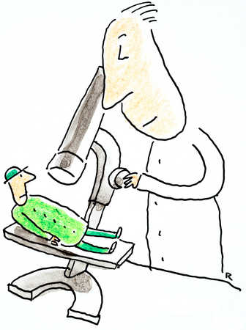
Diagnosis
We would want to spend half a day on diagnostics with the target participants and HR stakeholders.
Our Requirements :-
Half an hour telephonic conversations with :-
3 Participants
1 HR Stakeholder
1 Business stakeholder/ leader
Our Curiosity :-
Understanding their role, responsibilities
Understanding their relationships with the team members
Understanding dependencies of different people within the team structure
What is the current state of the team vs their desired state
Obstacles faced while knowledge and resource sharing
Leader’s expectations from the team members
Expectations from the leader
Organizational structure of the department ( from the HR stakeholder)
Gathering in depth examples of the curiosity mentioned above

Slide 7

Design
Post the diagnosis, we get into the design phase of the learning intervention.
Here are 3 things we will do:
Diagnosis report: A report is generated which would reflect the outputs from Diagnosis (The identity of the participants would be confidential).
Design Customization: The consultant will design the final objectives and customize the content of the learning intervention. Modules of the workshops are designed, activities are mapped to the examples, new handouts are drafted based on the content.
Design Presentation: The final objectives and design of the learning intervention are presented to the learning partners/stakeholders via skype/call/in person

Slide 8
Sample Learning Objectives: Post the workshop participants will:
Think
I can make a bigger impact when I collaborate with my team and use strengths of others
I will take ownership and go the extra mile to finish tasks
I need to see the other person and make them shine
We need to work together and accept each others ideas
If we have regular conversations and share our feelings with each other, we would be able to establish deeper connect with each other
I will always be eager to learn and gain knowledge
I am ready to get up and implement my ideas
Feel:
Bonded to work & collaborate in a more exciting way
Aligned with my team members
Excited to work together
Curious around how to bring my ideas to life
Ready to implement new thoughts and ideas
Be more able to:
Leverage strengths and growth opportunities across teams for individual’s and team’s benefits
Build productive, long-term mutually beneficial partnerships with each other
Build an enabling environment that leads to better organizational performance
Share knowledge and resources to support others to perform outstandingly
Acknowledge and appreciate each other
Take more ownership and responsibility
Learn and be more creative and innovative
Be fine with setbacks and willing to try other ways to achieve
7

Slide 9
Sample Workshop outline: Day 1 - Max 10 participants per consultant
Narrative | Session | Session details | Methodology
Getting acquainted with Maynard Leigh | Introduction | Welcome and a warm up, setting the context Maynardleigh & facilitator Introduction | Theatre exercise. Experiential context setting
Sharing stories that are not commonly asked and are very personal. Getting to know each other better through personal disclosures | Speed Dating | 20 minutes, 20 different partners and 20 questions the ultimate self disclosure challenge. The participants are asked to share answers to the questions written in the chits shared with them | Group Activity
The teams create desired state for themselves where a clearer picture of their vision as a team is formed | Creative Perspective of Team | The team is divided into groups of 8 where they create advertisements stating the current state of the group (relooking present) and that is how we want it to be (build future) | Theatrical exercise
The team reflects on the three questions asked | Line Of Continuum | How important is team work? How do you rate yourself as a team member? How do you rate the organization in terms of team work? | Theatrical exercise
To be able to collaborate with each other, and build positive relationships, we need to check the behaviors around how everyone is currently working together. | Team DNA: Blood Test | To create a highly engaged atmosphere where leaders/team members can gauge their current state & then talk about key excellence, leadership and cross-functional team co-ordination attributes like communicating to increase co-ordination, strategizing for effectiveness, planning, cascading vision, building an internal service culture, being proactive and focusing on process orientation for implementing goals. | A high adrenalin team game, to check team’s behaviors'.
We are constantly creating patterns of behaviour. The benchmark for our potential that we set for ourselves, stays for life. How we choose to perform will stay with us for the rest of our lives. The gap between our potential and actual performances is what often stands between achieving or not achieving our visions. | Psychology of Peak Performance | The facilitator shares research from the world of sports psychology that talks about the formation of patterns as we get older. What is the work-behaviour pattern that you want to create? | Facilitator Led

Slide 10
Sample Workshop outline: Day 1 continue - Max 10 participants per consultant
Narrative | Session | Session details | Methodology
How do we collaborate and respect each other? Introducing the principles of collaboration | Principles of Collaboration | Participant explore rules of creative collaboration- Accept & Build, Make the other Shine, There are no mistakes only opportunities, Take Risks. Participants learn the rules of collaboration through various experiences. | Improv Theatre
Every idea is important. Let us learn to acknowledge what is it that we accept and then we give another perspective. | Yes Anding | A tool shared with the participants where the important of acknowledging the idea, accepting it and then giving another perspective is shared | Improv Theatre
While the teams have gotten an understanding on the pillars of collaboration, we create an experience where the leaders learn to share their feeling with each other and not create perceptions | Spy | Teams will be competing with each other. Job is to replicate the model that has been kept in the cupboard in 15 minutes. Powerful way to uncover that we live in assumptions and our subjective reality may be guided by our perceptions. A total shake up experience for participants. | Facilitator led activity
Summarizing & cementing the learnings from the day – For the group | Trust Contract | Team democratically vote and choose the top 3 behaviours that they will live and demonstrate together for at least a year. | Group plus individual activity
Summarizing & cementing the learnings from the day – For the participant | Closing | Participants finalize what they will START doing, STOP doing & CONTINUE doing. Goodbyes | Action planning completion

Slide 11
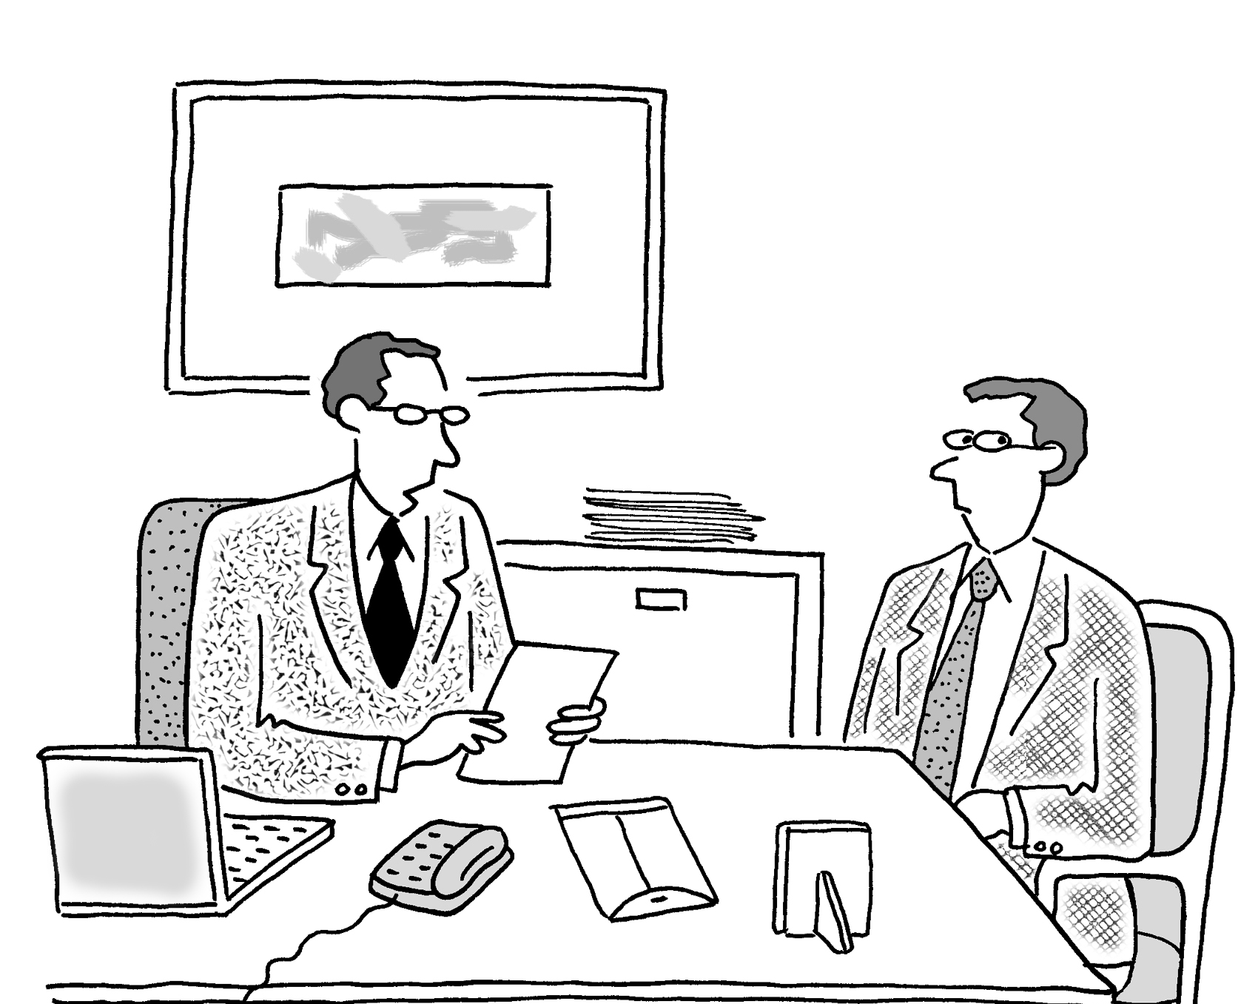
Discover
A one to one meeting with HR stakeholders to take feedback on the intervention and how it was received and next action steps.

Slide 12
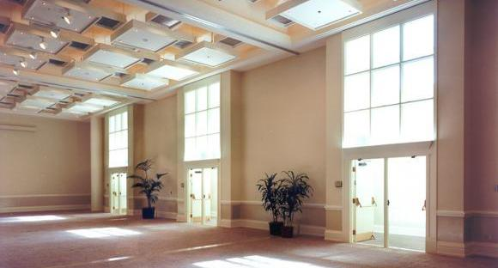
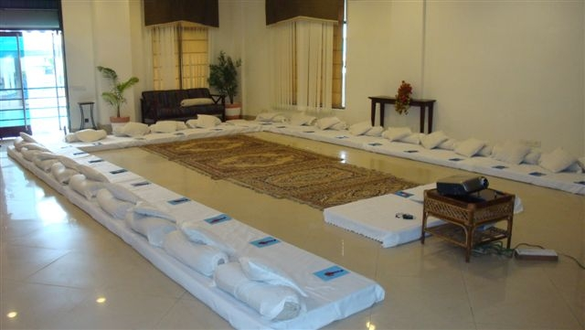
Room layout
The Setting
We love alternative ways of setting up a workshop! Creating an atmosphere where the participants feels absolutely comfortable and yet challenged. In this workshop, the use of theatre, team games and experiential methodologies are essential ingredients, hence we’d require gaddas to make participants comfortable and ample place to move around and make noise.
Please book a space with ample natural light (Yes, we want sunlight streaming in) and no fixed furniture for the participants to work with one MaynardLeigh consultant.

Slide 13

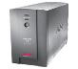


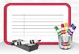
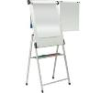

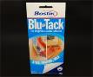
Things Required at the Venue
For the workshop, we will need the below mentioned:
LCD projector and projection screen
UPS Power Back-up for Laptop, LCD projector & Laptop speakers
External speakers (for laptop connectivity). The external speakers should be loud
enough to play music for the team.
White board & White board markers (2 blue, 2 black, 2 green)
Flip chart and Flip chart stand with suitable clips
Colour pens (Normal sketch pens - about 30)
Notepads and pens (for participants)
Blu Tac (This substance is used to stick things, posters or paper on the wall)
20 A4 Size normal and drawing sheets
Gaddas required for the room seating ( 8 inches)
2 tables for the consultant( one will be used for the projector and the other for keeping the handouts)

Slide 14
Your Investment
Diagnose & Design (For the whole Intervention)- A
Half Day Diagnosis & Half Day Design |  | INR 70,000/-
Delivery (for 10 participants)- B
Activity | Investment
Professional fee for delivery of 1 day JUICE workshop Learning Material, Do IT NOW cards, folders and certificates | INR 70,000 per day per consultant X 1 days X 1 consultants INR 650 per participant X 10 participants |  | INR 70,000/- INR 6,500/-
Total Investment for journey covering 10 Participants ( A+B) |  |  | INR 1,46,500/-
Total investment per participant |  |  | INR 14,650/-

Slide 15
Commercial Terms and Conditions
Client is responsible for providing venue, conference facilities, AV equipment.
Travel outside Delhi NCR - Air, stay & airport/ venue cab transfers to be taken care by the client.
Travel inside Delhi NCR - at Rs. 12.00 Per Km.
Not inclusive of applicable taxes (GST@ 18%)
A commercial contract will be signed before the execution of the project.
50% of cancellation fee will be charged on any cancellation or postponements that occur within 20 working days of the confirmed date of delivery.
100% of cancellation fee will be charged on any cancellation or postponements that occur within 0 to 2 working days of the confirmed date of delivery.
The above commercials are valid till the 31st March, 2018
Contracts, legal & accounting paperwork (including billing & payments) will be in the name of “Life Strategies Humancare Pvt. Ltd.”

Slide 16

Next Steps
Book: Let us block the dates for the Diagnosis and Design right away so that we have consultants available for you.
Contracting and PO: Once we close on the vendor empanelment, let us close on the contract and PO.
Vendor Empanelment : Since we are working with Honeywell after a very long time do let us know if there is any vendor registration process that we have to undertake.

Slide 17

Let’s work in partnership to create impact & unlock potential
For further information please connect with:
Contact Wade Calvert
Email wade@maynardleigh.in
Telephone +91 8404883592

